Slide 1



Weather Forecast
PROJECT MEMBERS :
Kamalesh M - 23ITR076
Megavarshini M - 23ITR097
Priyanka K - 23ITR0121
JAIHARI D (19ITR028)

Slide 2

Developed a Python GUI application for real-time weather forecasting.
Integrated OpenWeatherMap API to retrieve weather data.
Designed an intuitive interface for users to access current weather conditions and forecasts.
Allows users to search for weather information in various locations.

Slide 3
Objectives
Ensure that the development environment is properly configured to support Python GUI development and API integration.
Integrate OpenWeatherMap API to fetch weather data.
Develop a user-friendly graphical interface using Tkinter
Efficiently handle and display weather data fetched from the API.
3

Slide 4
Software / Hardware Tools used
Software used :
Microsoft Visual Studio Code
Python GUI development –Tkinter
API integration – OpenWeatherMap
4

Slide 5
Implementation Details
Environment Setup: Install Python, Tkinter, and requests library
API Integration: Obtain API key from OpenWeatherMap and use requests to fetch data.
GUI Design: Create a Tkinter window with an input field, a button, and labels to display weather information.
Data Handling: Parse API response to extract and display temperature and conditions.

Slide 6
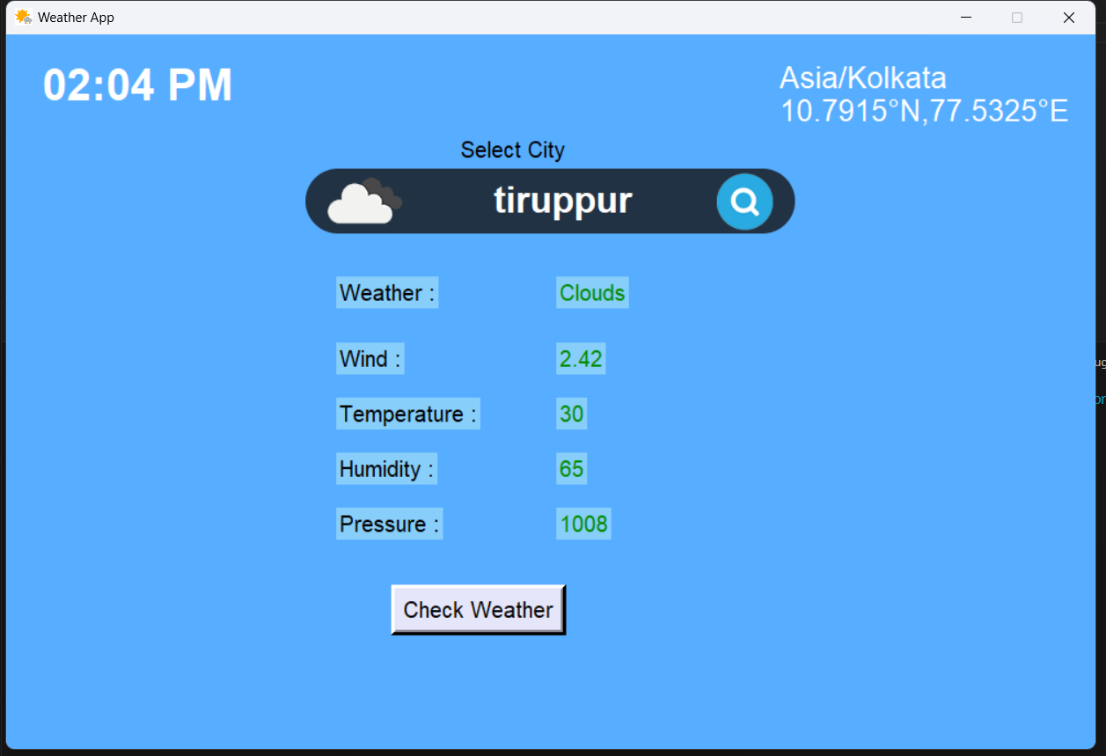
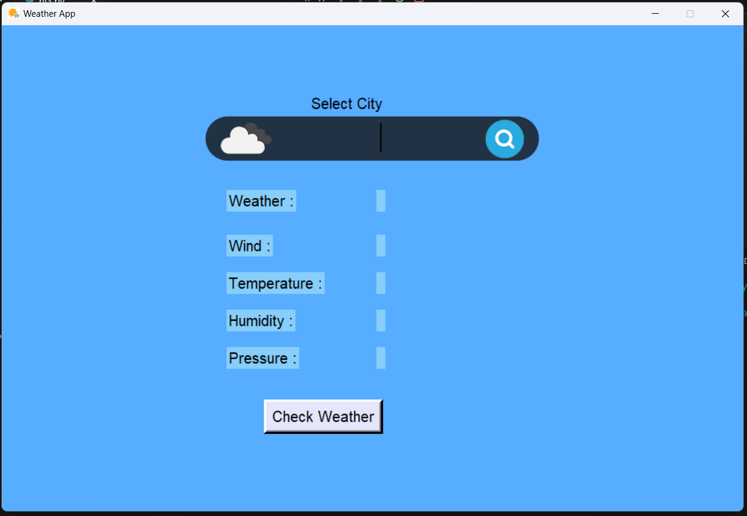
Module
input
output

Slide 7
Reference
https://www.python.org/about/gettingstarted/
https://www.w3schools.com/python/
https://www.geeksforgeeks.org/python-programming-language-tutorial/
https://www.javatpoint.com/create-a-gui-for-weather-forecast-using-openweather-map-api-in-python
https://www.askpython.com/python/examples/gui-weather-app-in-python
https://techbit.in/#google_vignette
https://techbit.in/programming/code-a-weather-app-in-python-using-tkinter/

Slide 8
Thank you!

